Slide 1
Hindi

Slide 2
Fun facts about the Language
It’s the official Language of India
There is a different dialect spoken in Fiji, but considered different
It has approximately 310 million native speakers
Fourth most spoken Language in the world
It’s the lingua franca of only part of India

Slide 3
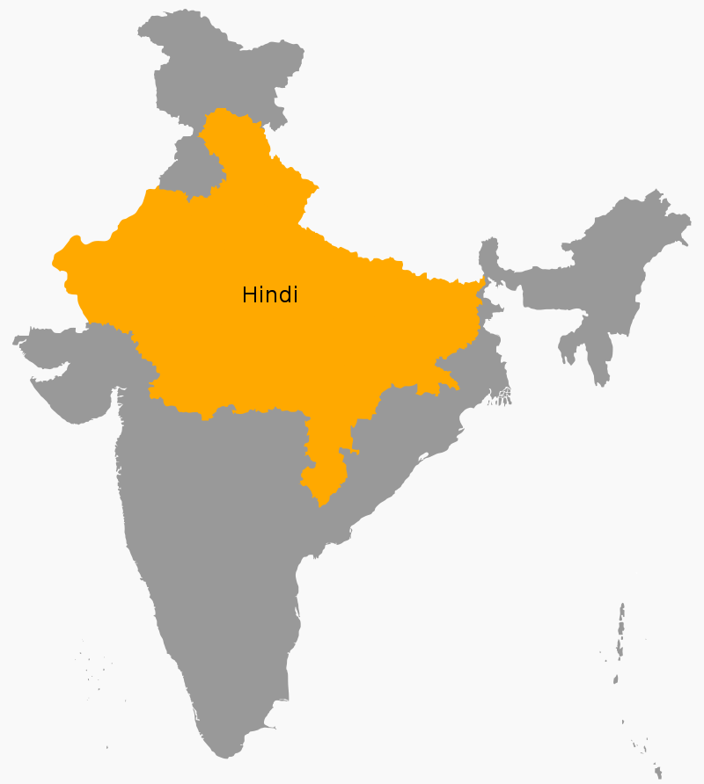

Slide 4
Fun Facts Continued….
Hindi is an Indo-European language
Along with Urdu, it’s also referred to Hindustani
Regional languages such as Gujarati and Marathi are similar
It’s an SVO language
It’s synthetic
masculine/feminine
Also a

Slide 5
Difficulties in NLP

Slide 6
Example
मेरा नाम आरिफ है
meɾa naam Arif Hai
My Name Arif Is

Slide 7
Example (Not Zootopia)
https://www.youtube.com/watch?v=is6d3UrGqyw

